Slide 1
ECE 3436 Microprocessor Systems Notes 6c: Data Storage -- RAM & ROM
Ph.D. Jianfeng Zheng
Dept. ECE, Univ. of Houston
Email: jzheng4@central.uh.edu
Feb 21, 2026
Adapted from notes by Dr. Diana De La Rosa-Pohl

Slide 2
Today’s agenda in ECE 3436
Create constants in ROM
Create variables in RAM
Read constant values from ROM
Write variable values in RAM
Read variable values in RAM

Slide 3
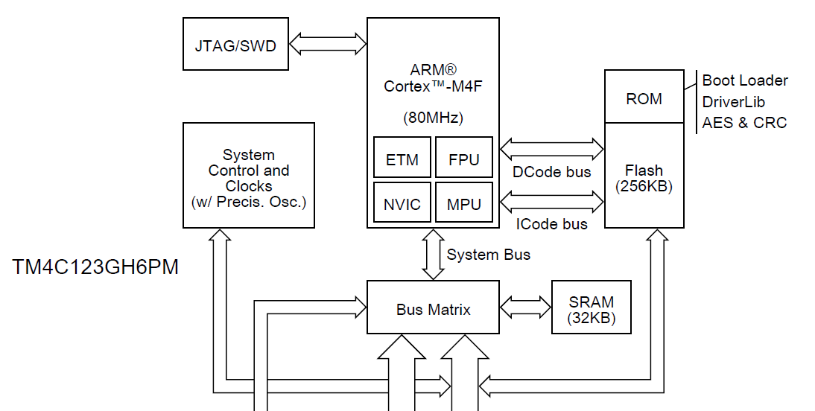
Defining/Creating Variables – SRAM
We are here

Slide 4
RAM Memory Access
Micro
Processor
Address (32 bits)
RAM
(Variables)
System bus
Data (32 bits)
0x2000.0000 − 0x2000.7FFF
(32 K)

Slide 5
Defining (Uninitialized) Variables
C data types
int AGE;
Char AGET[7];
Assembly SPACE directive
AGE SPACE 4
AGET SPACE 7
Create a space in SRAM memory to hold the value of AGE and AGET
Value can be changed when running the program

Slide 6
In-class Activity 0
Create an AREA in memory (RAM) for your variables
Use the AREA directive
Give the area a name
Make it an area for DATA (as opposed to code)
Set it up to be READWRITE
Align the area in RAM to start on a memory address that is a multiple of 4

Slide 7
In-class Activity 0
Create the variables to the right
Use the SPACE directive
Place directive in DATA AREA of file
Global variables are permanent at a fixed location in RAM
Exist for the life of the program
VARA SPACE 4
VARB SPACE 2
VARC SPACE 1
…

Slide 8
Storing Values in Variables – Loading an address
LDR Pseudocode version
LDR Rd, =variable_name
LDR R0, =VARA
LDR R1, =VARB
LDR R2, =VARC
LDR R3, =otherVarName
…

Slide 9
Storing Values in Variables – Storing to an address
Using the STR instruction
STR Rs, [Ra]
STR R1, [R2]
go to the memory address that is stored in R2
Store the 32 bits in R1 at that address
STR R3, [R5]
go to the memory address that is stored in R5
Store the 32 bits in R3 at that address
Store the value in Rs into the bytes at the memory location in Ra.

Slide 10
In-class Activity 1A
Storing data into RAM from a register
Step 0
Load a register with the value −1
Step 1
Load the address of the constant or variable into a register
Ex: LDR R1,=VARA
R1 now contains the memory address of VARA
Step 2
Store the value in a register to a variable in RAM
Ex: STR R0, [R1]
VARA now has the value in R0

Slide 11
In-class Activity 1B
Storing data into RAM from a register
Now give the variables VARB and VARC the values 0x1234 and 0xAB
VARB = 0x1234;
VARC = 0xAB;
Pay attention to the size of the variable
Check values in memory window
To store value to a 16-bit variable
→ STRH
To store a value to an 8-bit variable
→STRB

Slide 12
Loading A Variable Value From RAM
Step 1.
Load the address of the variable into a register
Ex: LDR R1, =VARA
R1 now contains the memory address of VARA
Step 2.
Load another register with the value stored at that address
Ex: LDR R3, [R1]
R3 now has the value in VARA

Slide 13
In-class Activity 1C
Load the values from the variables VARB and VARC into register R6 & R7
VARB → R6
VARC → R7
Pay attention to the size of the variable
Check values in memory window
To store value to a 16-bit variable
→ LDRH
To store a value to an 8-bit variable
→LDRB

Slide 14
Defining/Creating Constants – EEPROM (FLASH)
We are here

Slide 15
ROM Memory Access
Icode bus
(Program)
Address (32 bits)
Data (32 bits)
Micro
Processor
ROM
Dcode bus
Address (32 bits)
(Constants)
Data (32 bits)
0x0000.0000 − 0x0003.fFFF
(256 K)

Slide 16
Defining Constants
C const keyword
const int AGE=30;
const char AGET[]=“thirty”;
Assembly DC_ directive
AGE DCD 30
AGET DCB “thirty”,0
Create a space in ROM to hold the value of AGE while also initializing the value
Value cannot be changed when running the program

Slide 17
Defining Constant Data Sizes
Bits
Bytes B → 8 bits
Half words W → 16 bits
Words D → 32 bits
DCB
Define constant byte
8 bits, 1 byte
Aligned on 1-byte boundary
Mybyte DCB 0x23
DCW
Define constant [Half] word
16 bits, 2 byte
Aligned on 2-byte boundary
Myhword DCW 0x584A
DCD
Define constant double (=word)
32 bits, 4 byte
Aligned on 4-byte boundary
Mydouble DCD 0xABCDEF10

Slide 18
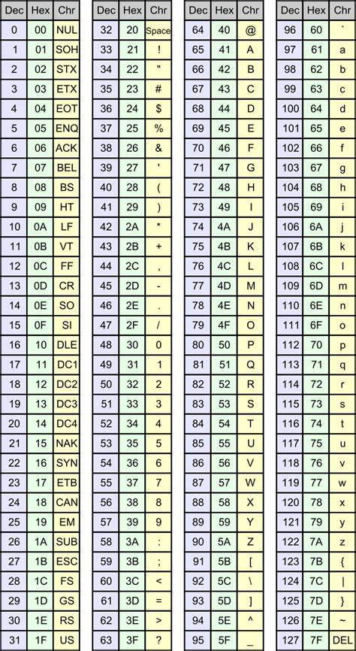
Defining Constant: Strings
Each character in the string is 1-byte (ASCII)
Must manually terminate the string with the null character (0)
Mystr DCB “Hello world!”,0

Slide 19
Loading A Value
SYNTAX
LDR Rd, [Ra]
Load Rd with the contents of the memory address stored in Ra
Examples
LDR R1, [R2]
Go to the memory address that is stored in R2
get the 32 bits stored there and load them into R1
LDR R3, [R5]
Go to the memory address that is stored in R5
get the 32 bits stored there and load them into R3

Slide 20
Loading A Constant Value From ROM
Step 1
Load the address of the constant or variable into a register
Ex: LDR R1, =VARA
R1 now contains the memory address of VARA
Step 2
Load another register with the value stored at that address
LDR R0, [R1]
R0 now has the value in VARA

Slide 21
Loading A Constant Value From ROM
Step 1
Load the address of the constant or variable into a register
Ex: LDR R1, =VARA
R1 now contains the memory address of VARA
Step 2
Load another register with the value stored at that address
LDR R0, [R1]
R0 now has the value in VARA

Slide 22
Reading/Writing Different DATA Sizes
Load (Memory → Register)
LDRB unsigned byte
LDRH unsigned halfword
LDR word
LDRD double (into 2 reg.s)
LDRSH sign extend halfword
LDRSB sign extend byte
Store (Register → Memory)
STRB store byte
STRH store halfword
STR store word

Slide 23
Reading/Writing Different DATA Sizes
Load (Memory → Register)
LDRB unsigned byte
LDRH unsigned halfword
LDR word
LDRD double (into 2 reg.s)
LDRSH sign extend halfword
LDRSB sign extend byte
Store (Register → Memory)
STRB store byte
STRH store halfword
STR store word

Slide 24
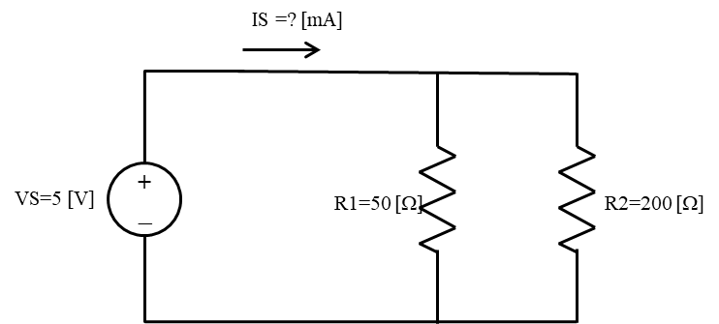
In-class activity 2: Parallel Circuit
Given: (Constant)
Vs = 5V (8 bits)
R1 = 50 ohm (16 bits)
R2 = 200 ohm (16 bits)
Solve for: (Variable)
Req = ?? Ohm (16 bits)
Is = ?? mA (32 bits)
Write the code to solve for Req & Is

